Slide 1
Stock-Market Simulation Deploy on Containers.
Sahil S. Gothoskar

Slide 2
Introduction
A stock market simulator is a program or application that attempts to reproduce or duplicate some or all features of a live stock market on a computer so that a player may practice trading stocks without financial risk.

Slide 3
Literature Survey:
Containers are nothing less than a new atomic unit on which application workloads are being both built and deployed.
Containers not only represent a better way to build more resilient software, they also inject unprecedented levels of flexibility and agility into enterprise applications.
The survey suggests that as IT leaders across titles / disciplines are being tasked to drive digital business transformation, at the core of almost every one of those initiatives is some form of container technology. Most of that adoption is being driven not only by developers, bu also IT leaders eager to position their organizations to take advantage of the next big shift in enterprise IT.

Slide 4
Brief On Systems:
Tech Used for various Snippets of Project:
Front-End:
HTML, or HyperText Markup Language, is used to create the basic structure and content of a webpage.
CSS, or Cascading Style Sheets, is used for the design of a webpage – where everything is placed and how it looks.
JavaScript is used to define the interactive elements of a webpage that help to engage users.

Slide 5
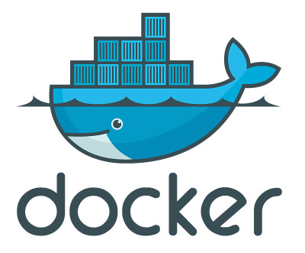

Front-End Framework:
- Machine Learning
Deployment:
Docker - Docker is a set of platform-as-a-service products that use operating-system-level virtualization to deliver software in packages called containers.
OpenShift - OpenShift is a family of containerization software developed by Red Hat. Its flagship product is the OpenShift Container Platform—an on-premises platform as a service built around Docker containers orchestrated and managed by Kubernetes on a foundation of Red Hat Enterprise Linux.

Slide 6
Implementation:
Firstly, before going to implement the solution we shall have a brief look at the architecture of Docker Architecture . It consists of various attributes such as container, images, network,data volumes and it has three basic layers.
The three basic layers are Docker Cli , Rest Api , Docker Daemon.
The basic workflow of my idea is that I’ll on Docker Engine first we need to install docker engine on our machine better if it is a linux machine. We can also perform in windows machine as well but the problem is that if we install docker on windows host and then try to run the docker engine then windows machine creates a linux environment for docker engine and then run it, which is the same as directly running on linux machine.

Slide 7
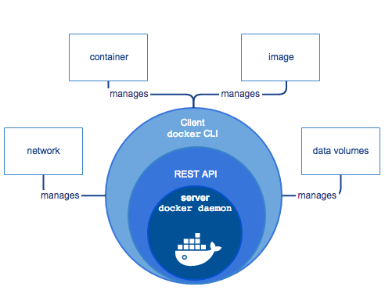
The basic workflow of my idea is that I’ll on Docker Engine first we need to install docker engine on our machine better if it is a linux machine. We can also perform in windows machine as well but the problem is that if we install docker on windows host and then try to run the docker engine then windows machine creates a linux environment for docker engine and then run it, which is the same as directly running on linux machine.

Slide 8
References:
Image taken from google they are copyright and are of respective companies.
Report entitled “2018 CONTAINER ADOPTION BENCHMARK SURVEY”

